Slide 1
PRCS252E - Presentation
By William Butler, Andrew Bellas, goel biju and Vincent Castellani

Slide 2
Introduction
In this presentation, we will be demonstrating various features of all three applications within our system. These three applications are desktop, web, and mobile (Android).
The team members who will be demonstrating are Andrew Bellas, William Butler, Vincent Castellani, and Goel Biju.

Slide 3
Content Outline - Mobile Application
The user stories that will be demonstrated for the mobile app are:
Create an account
Logging in
Searching for a journey
Booking a ticket
Viewing bookings
Viewing account details

Slide 4
Content Outline - Web Application
The user stories that will be demonstrated for the web application will be:
Logging in to the system
Viewing current coaches
Creating a new coach record
Editing a coach's capacity
Deleting a coach record

Slide 5
Content Outline - Desktop Application
The user stories that will be demonstrated for the desktop application will be:
Logging in
Selecting a shift
Starting a journey
Going to stops
Accepting bookings
Ending journeys

Slide 6
Mobile Application Demonstration

Slide 7
Mobile Application
Create an account:

Slide 8
Mobile Application
Logging in:

Slide 9
Mobile Application
Viewing account details:

Slide 10
Mobile Application
Searching for a journey:

Slide 11
Mobile Application
Booking a ticket:

Slide 12
Mobile Application
Viewing bookings:

Slide 13
Web Application Demonstration

Slide 14
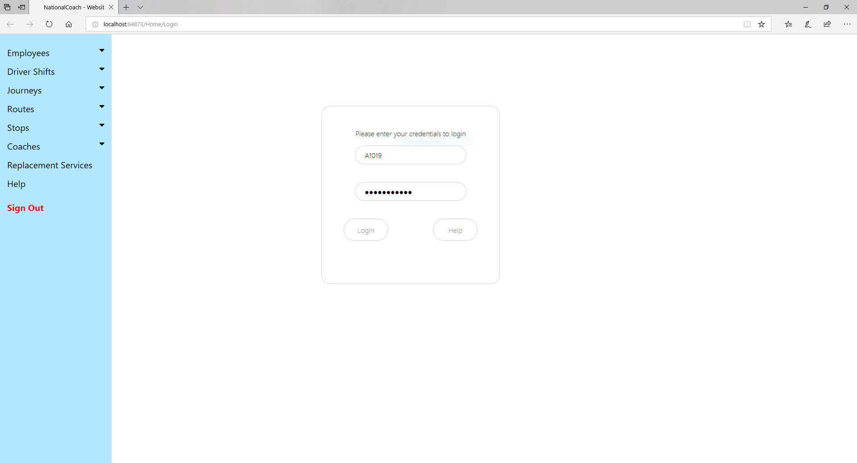
Web Application
Logging in:

Slide 15
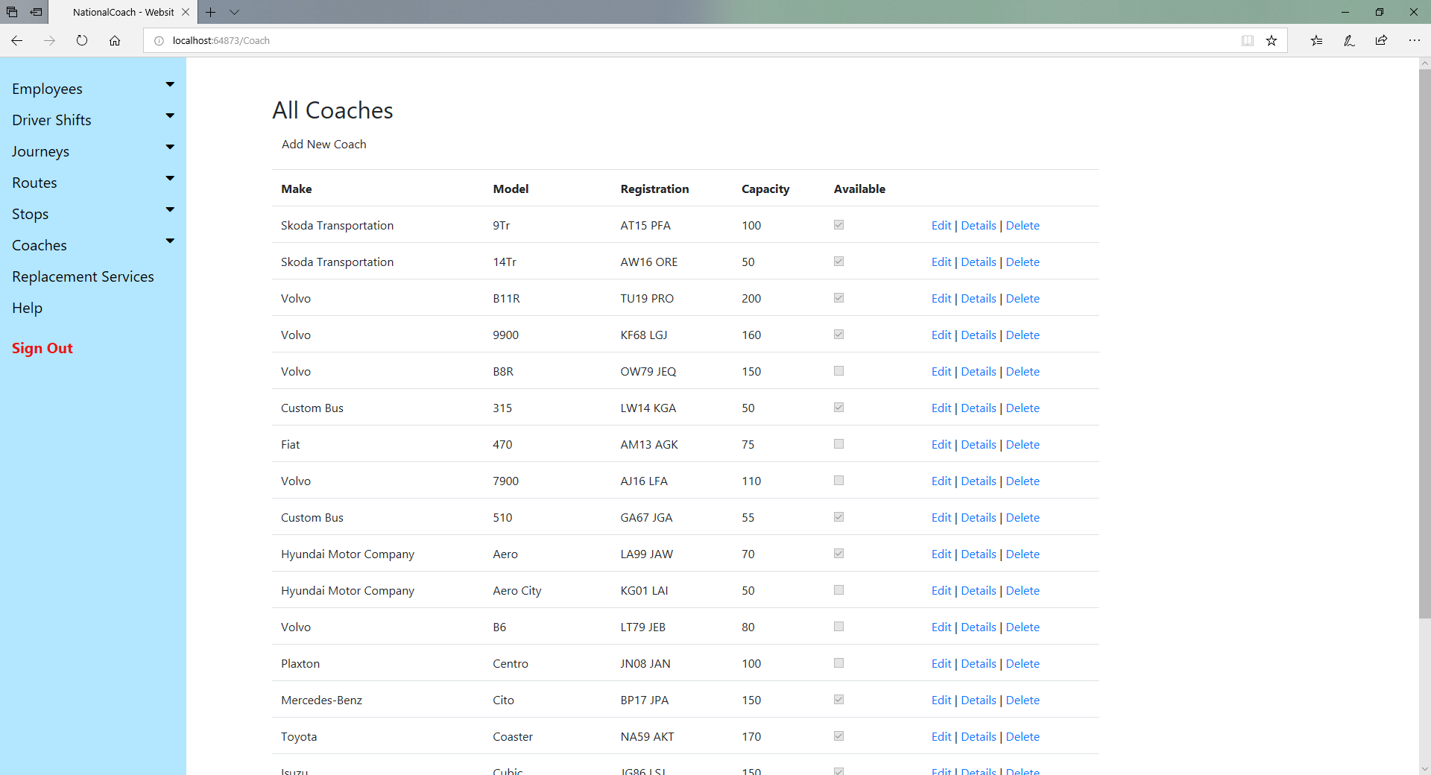
Web Application
Viewing current coaches:

Slide 16
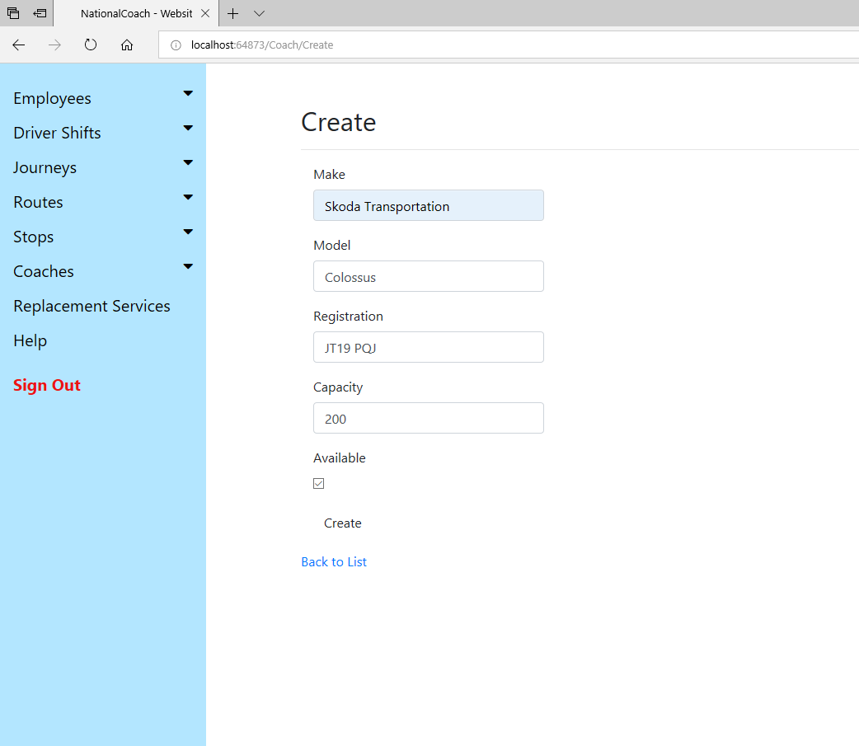
Web Application
Creating a coach record:

Slide 17
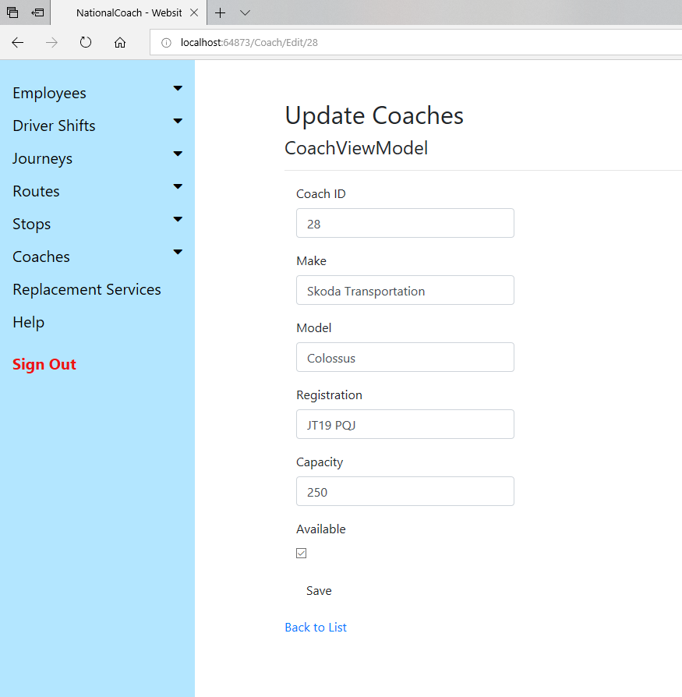
Web Application
Edit coach capacity:

Slide 18
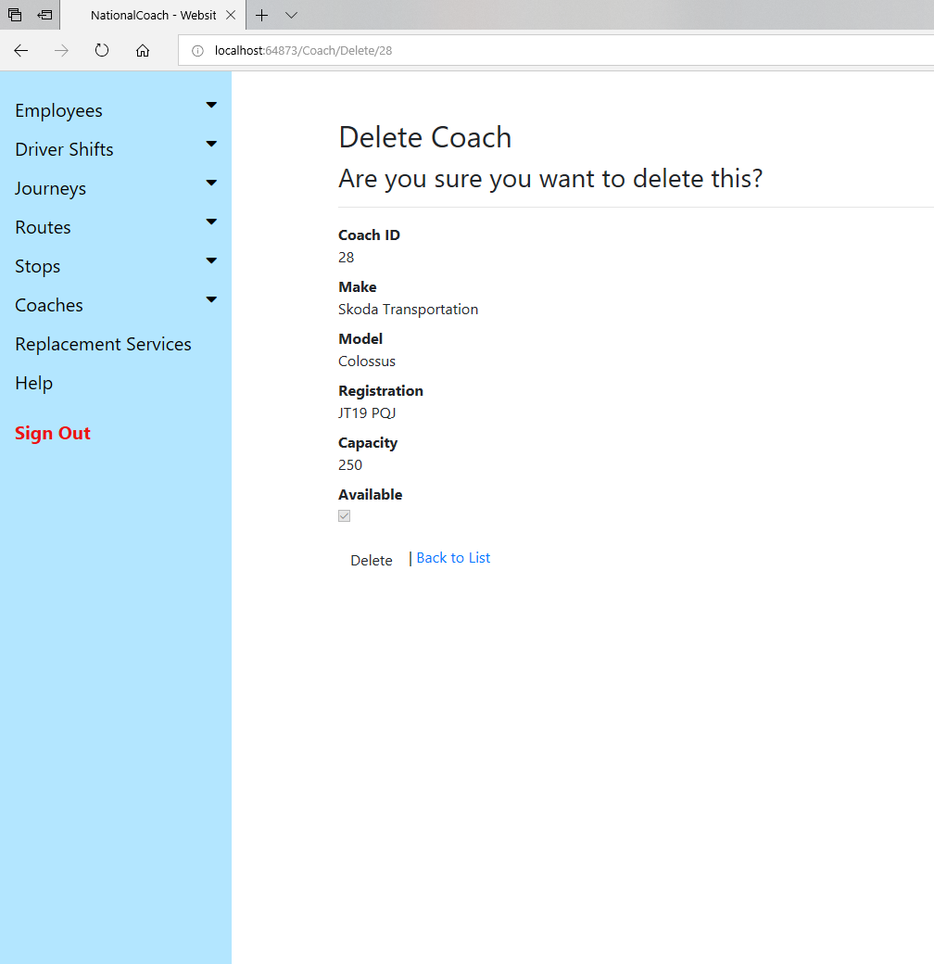
Web Application
Delete a coach record:

Slide 19
Desktop Application Demonstration

Slide 20
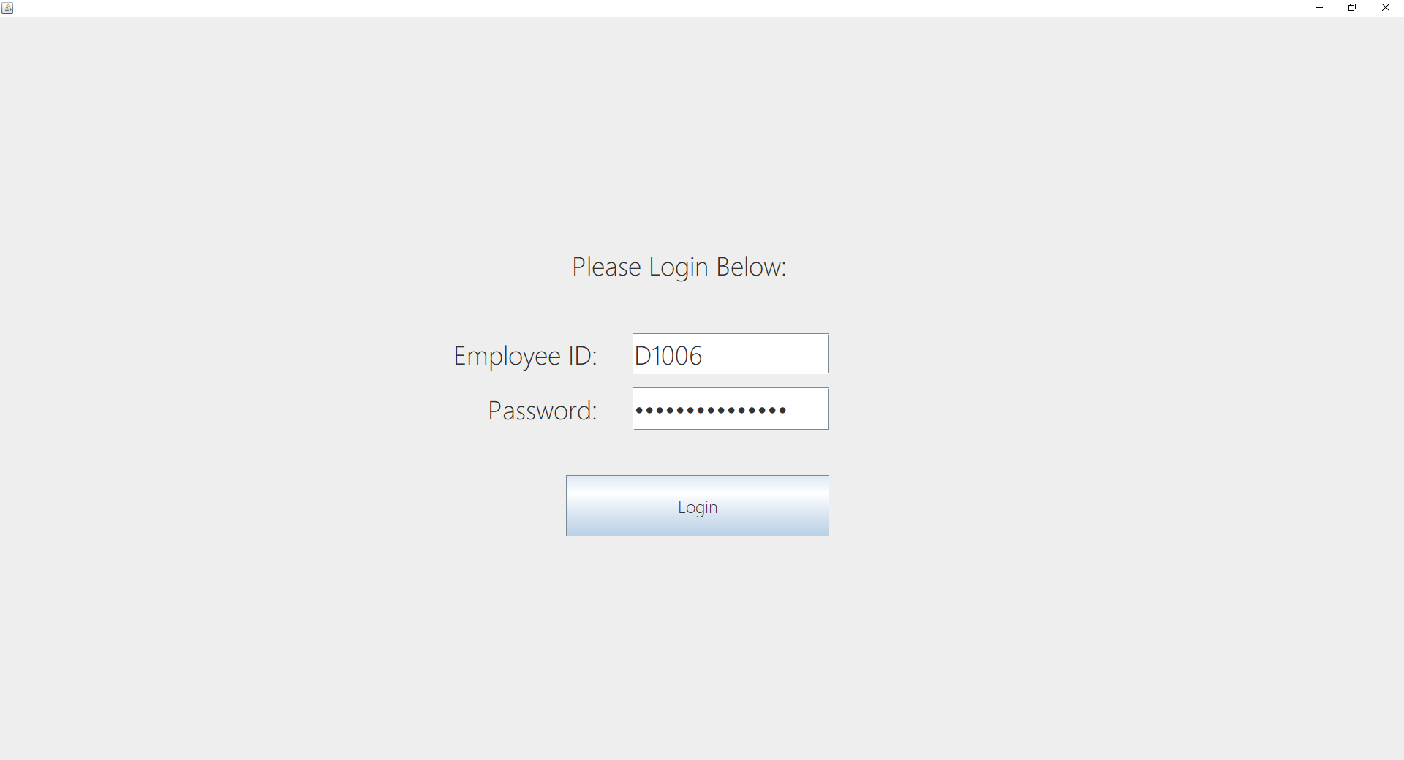
Desktop Application
Logging in:

Slide 21
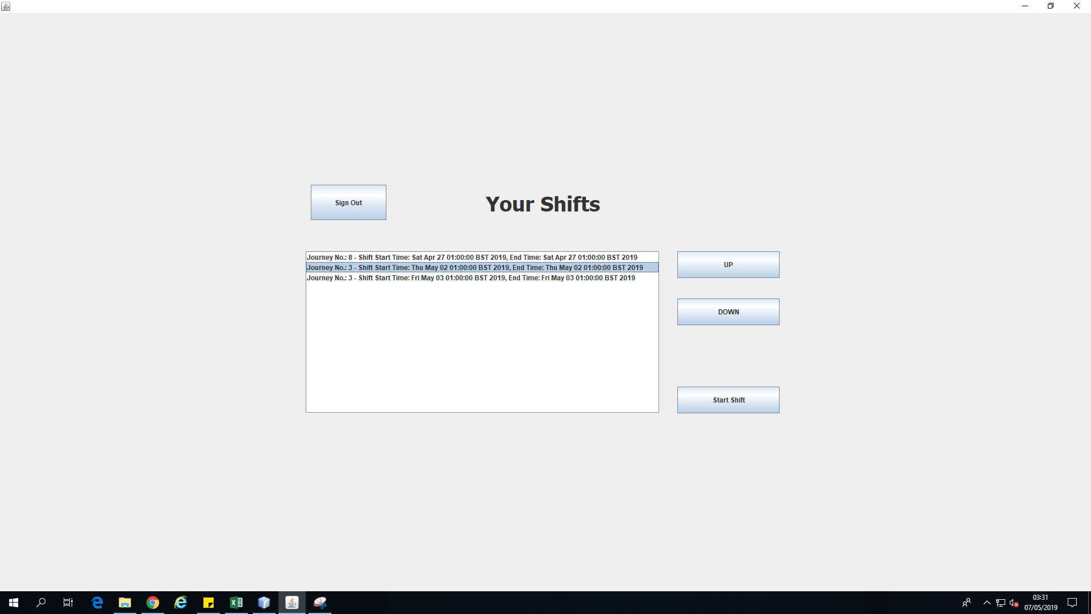
Desktop Application
Selecting a shift:

Slide 22
Desktop Application
Starting a journey:

Slide 23
Desktop Application
Go to stops:

Slide 24
Desktop Application
Accept bookings:

Slide 25
Desktop Application
Ending a journey:

Slide 26
Conclusion
To conclude:
Attempts have been made to create full CRUD functionality when and where possible.
HCI has been used in order to benefit the experience of the end user (e.g. large buttons on desktop app for touch screen use, simplistic UI for Android app, easily navigatable web app).

